Slide 1
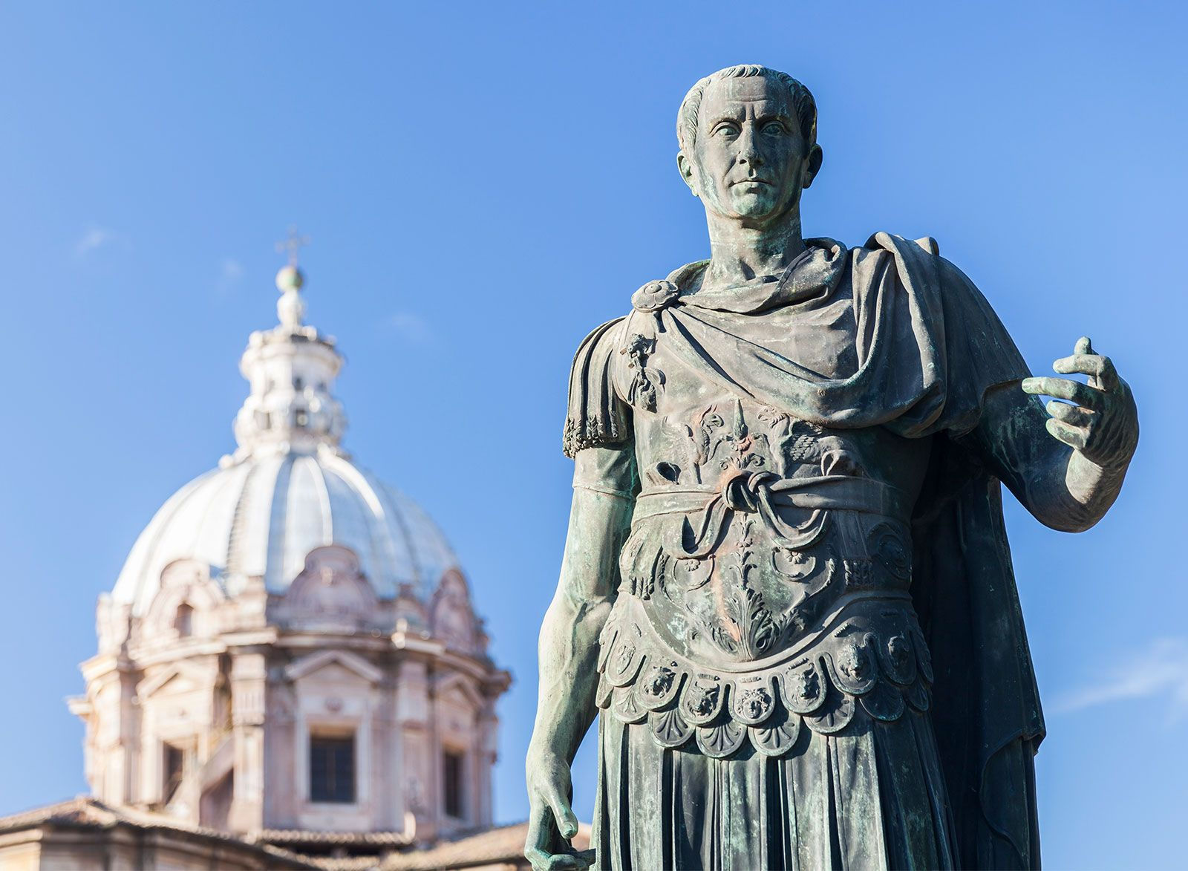
Challenges and Legacy
- Describe the challenges and legacy of JC
Week 7 Lesson 1
Ms Barrie

Slide 2

Overview:
Roman Emperors had a great deal of power and control. They were responsible as the head of the judicial system and courts. They also controlled the Empire’s religion. They were the commander and chief of the military. Augustus Caesar, who instituted the famous Pax Romana (Roman Peace) used the title of Senator, not Emperor.
In 45 BCE, Caesar became the first dictator of Rome after he defeated Pompey in a civil war.
People wanted to see him in a strong position of power so that he could solve the problems of crime, hunger, unemployment and taxes.
One of the laws of the original Twelve Tables was that no general could enter the city with his army. Julius Caesar ignored this law. In 49 BCE, he entered Rome with the Roman Legion and took over the government.

Slide 3
Overview:
The Senate was furious. Caesar was assassinated by in 44 BCE.
In ancient Rome, senators were the only people allowed to wear togas edged in purple cloth, and Emperors were the only ones allowed to wear all purple. Instead of crowns, Roman emperors wore laurel leaves on their heads.
The death of Julius Caesar marked the end of the Roman Republic.

Slide 4
Today’s Lesson
Key people – Challenges and influences
Legacy

Slide 5

ACTIVITY - Worksheet
Key people
Challenges
Influences

Slide 6
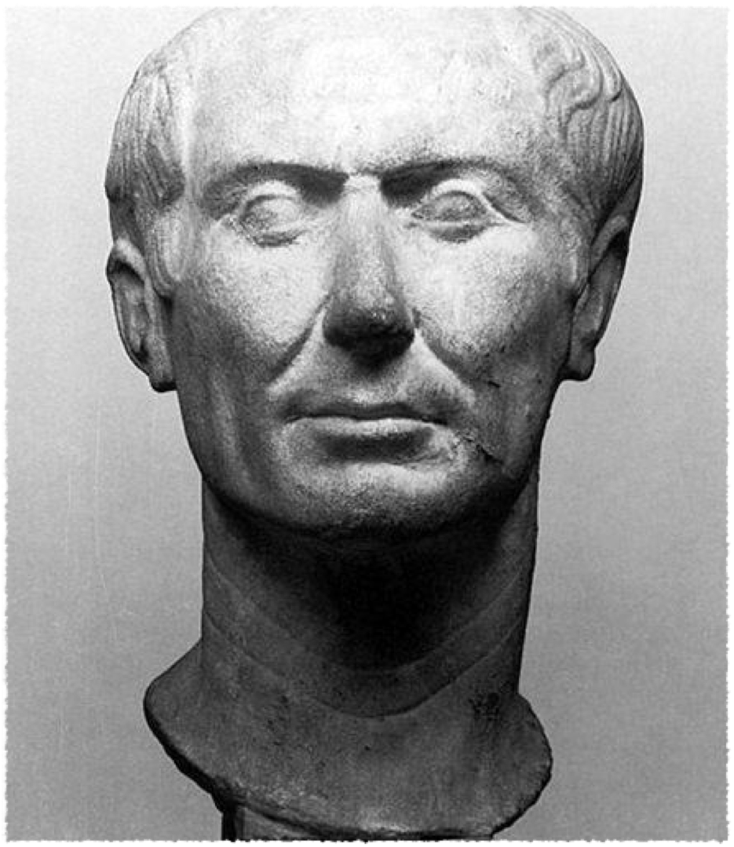
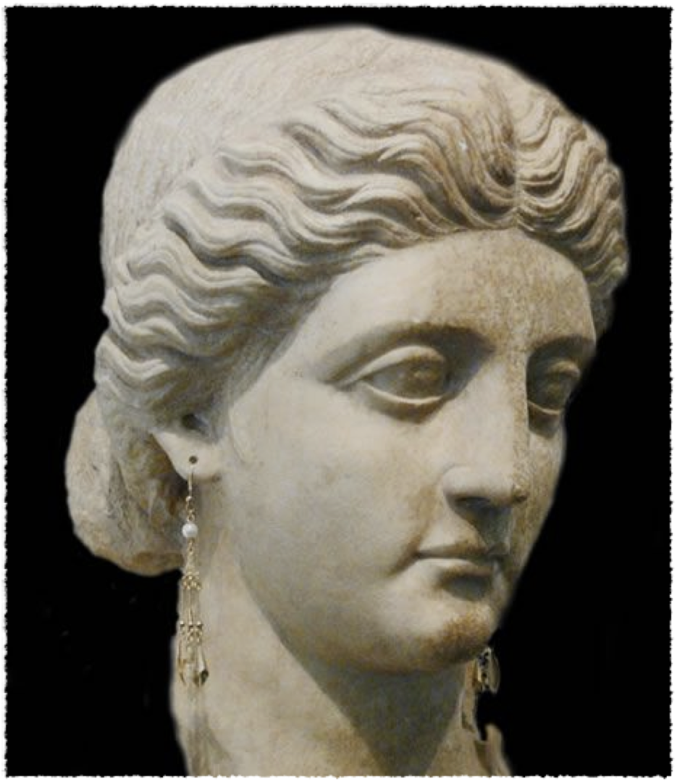
Gaius Julius Caesar & Aurelia

Slide 7
Gaius Julius Caesar & Aurelia
Father and Mother of JC
Father died around 85 BCE – JC head of family at 16
Father governed the province of Asia and his mother, Aurelia Cotta, was of noble birth.
Populares ideology - favored democratization of government / more rights for the lower class
opposed to the Optimate factions’ claim of the superiority of the nobility and traditional values which favored the upper classes
political ideologies which many people shifted toward and from, regardless of class in society
concept of appealing to the people for support, rather than seeking approval from the senate or Patricians would work well for Caesar later in life.

Slide 8
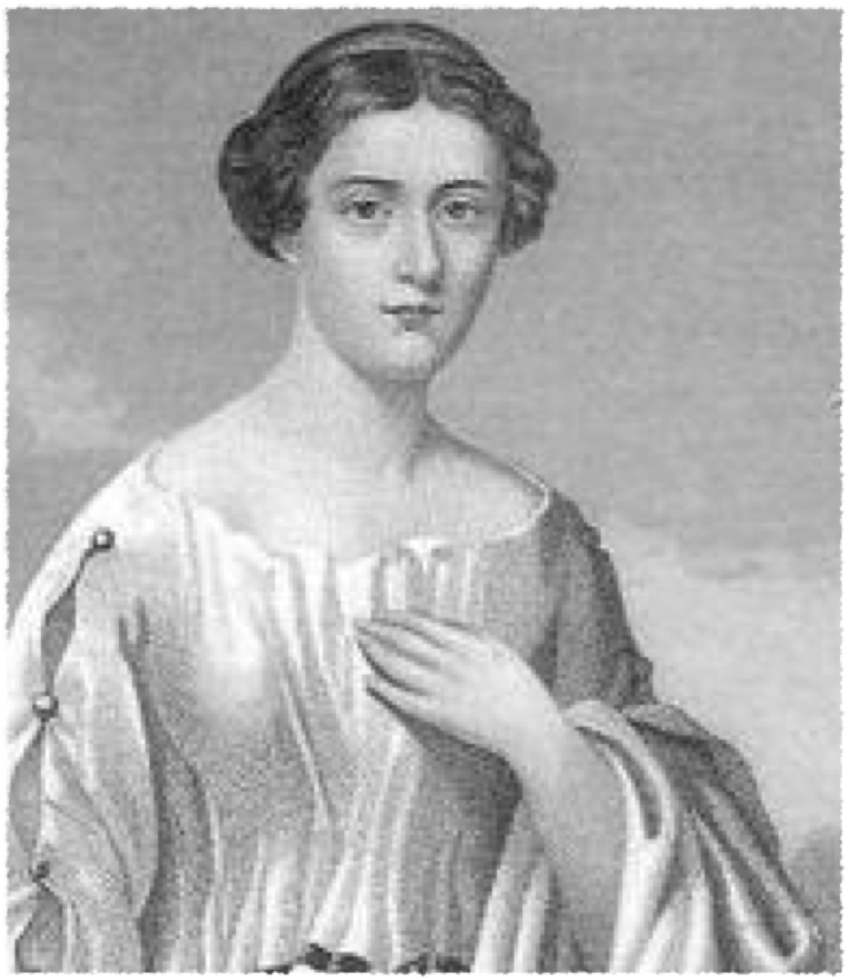
Cornelia, Julia

Slide 9
Cornelia, Julia
Cornelia – Wife of Caesar
A daughter of Lucius Cornelius Cinna , Cornelia was related by birth or marriage to many of the most influential figures of the late Republic
Julia - Daughter
only legitimate child
Married Pompey the Great

Slide 10
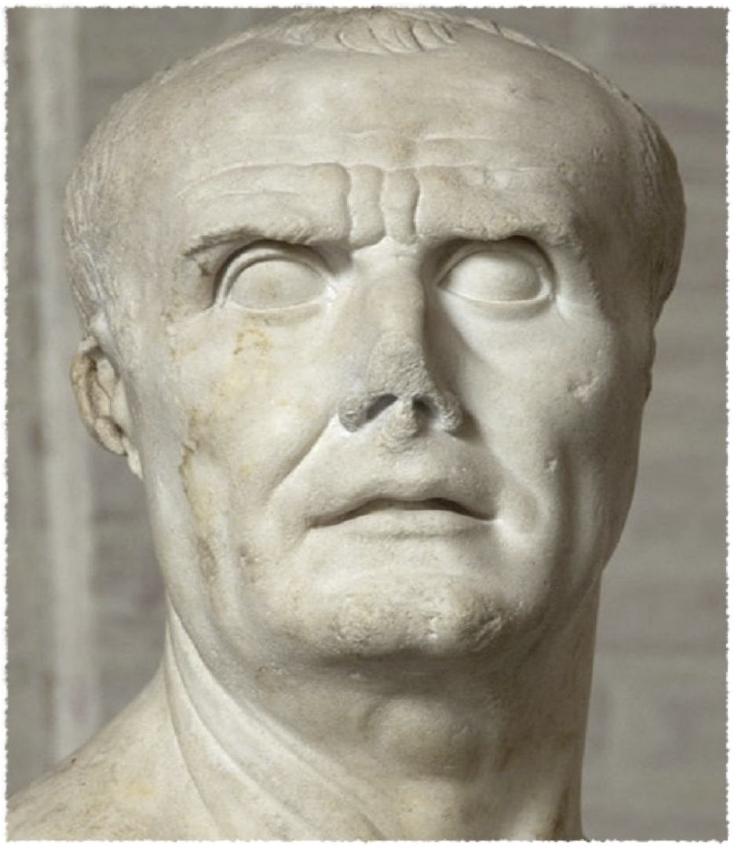
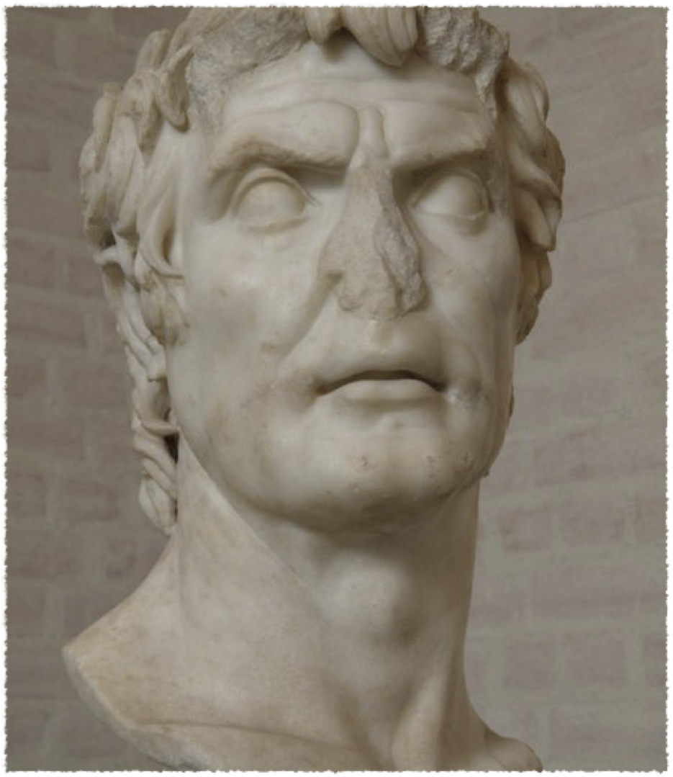
Marius and Sulla

Slide 11
Marius and Sulla
The division between the two factions (populares and optimates) had begun in earnest during the era of the Gracchi, two generations earlier, and the contest between them eventually led to the Caesarean Civil war
BUT forty years before their final show-down the parties engaged a terrific frenzy of bloodshed, known as the Civil War of Marius and Sulla.
Although Marius himself was already dead before most of the fighting began, the populares party, which had supported Marius, was thereafter known as the "Party of Marius."
Sulla ordered him to divorce wife but refused - went into hiding but pardoned. Died 78 BCE

Slide 12
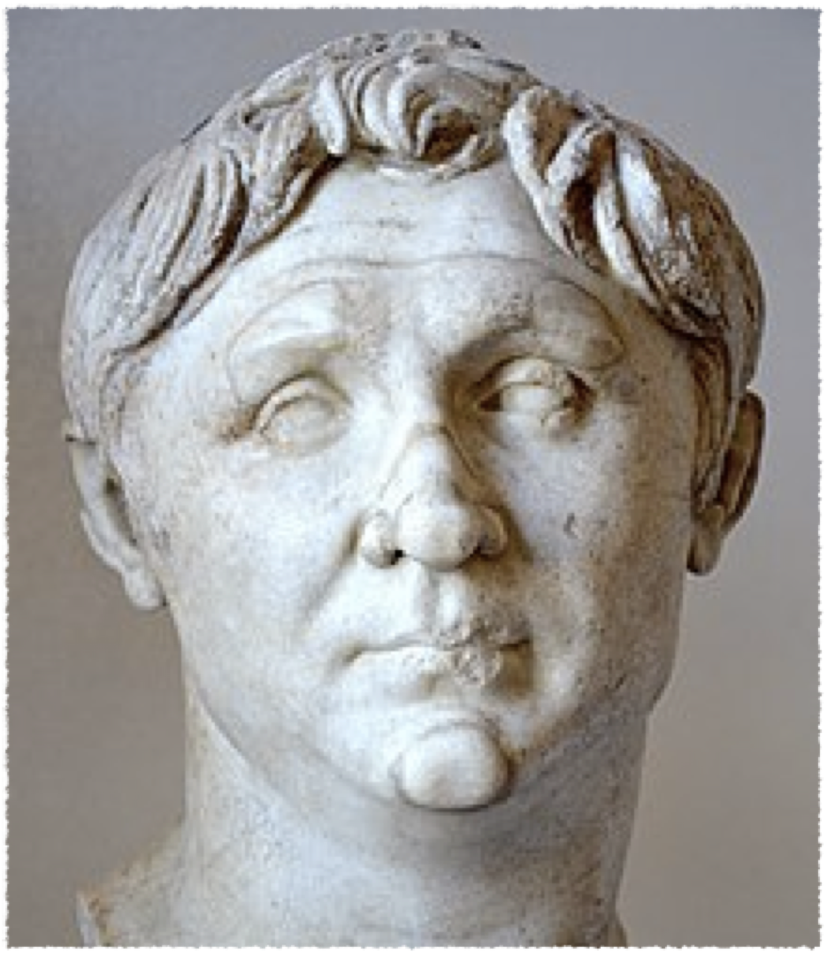
Pompey the Great

Slide 13
Pompey the Great
Married to Caesar’s daughter Julia
106-48 BCE, was a general in the Roman army under the rule of Sulla.
When Sulla died in 78 BCE Pompey took this opportunity to ask the Senate for a series of special high commands so he could deal with the revolts that were plaguing the Republic at that time.
Pompey quickly dealt with the many problems plaguing Rome while all the time gaining more Senate approved powers.
In 70 BCE Pompey joined forces with the newly elected Consul, (and future triumvirate member), Crassus.
Before Pompey joined the triumvirate he single-handedly redrew the map of the Eastern Mediterranean by developing new cities through conquest. Pompey, through his victories had increased Rome’s annual income by 70 percent.

Slide 14
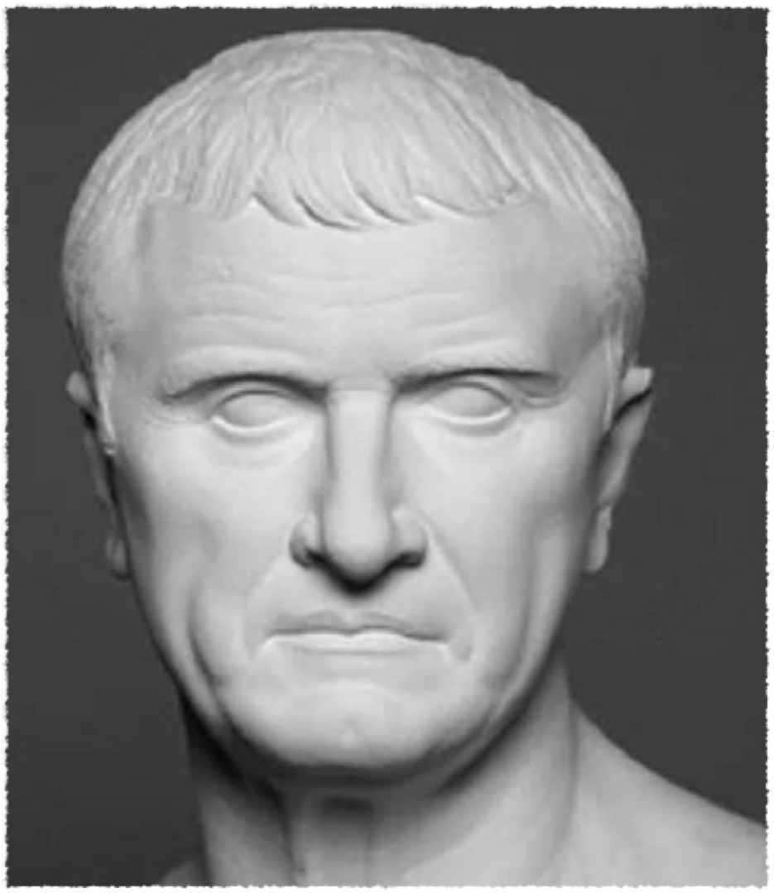
Crassus

Slide 15
Crassus
Wanted to further his name and status
Went to Syria
Killed in 53 BCE
Late Republic as Rome’s richest man. Though not born into a life of money, Crassus gained much of his wealth through greedy schemes by becoming the cities greatest landlord.
Crassus used this money to support political ambitions, which lead to his being appointed Consul in 70 BCE.
Crassus’s biggest military achievement was his defeat of Spartacus and the slave revolt in 71 BCE.
Crassus, had joined forces in 70 BCE with Pompey, and would eventually help form Rome’s triumvirate by 60 BCE.

Slide 16
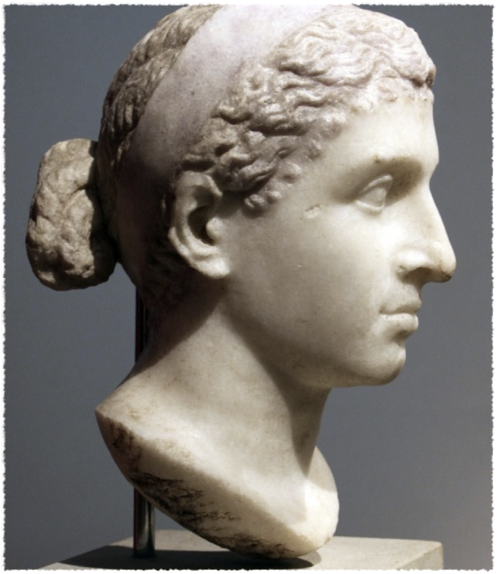
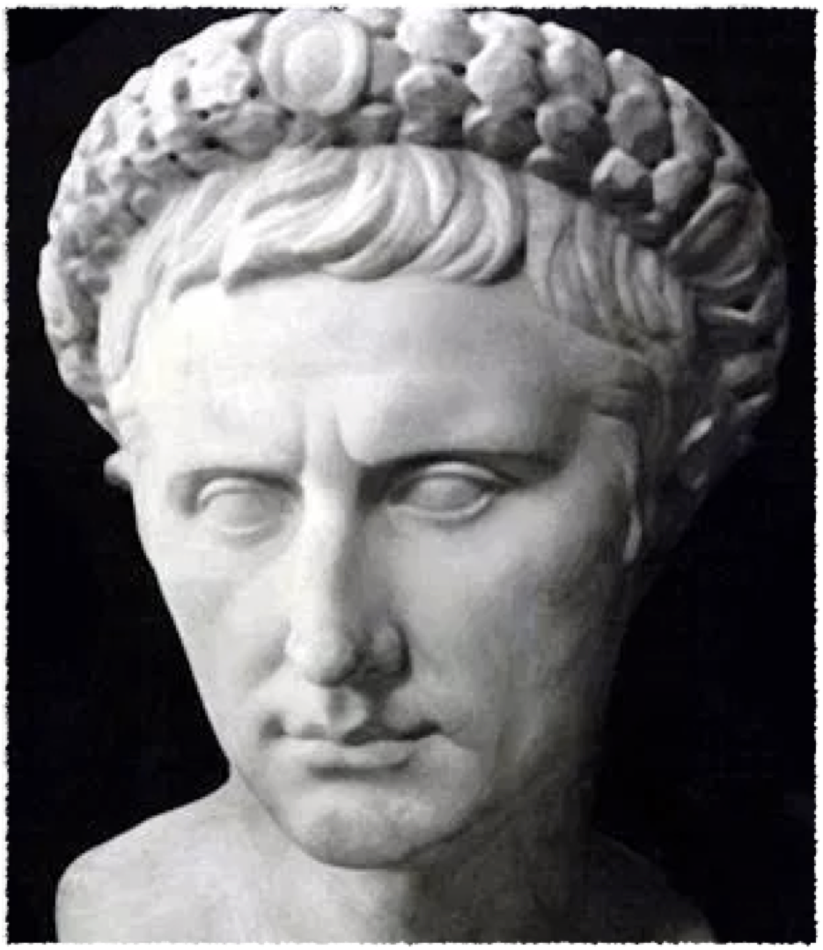
Cleopatra VII and Caesarion

Slide 17
Cleopatra and Caesarion
Asked JC to help get throne - 47 BCE ruler
Caesarion - son of Caesar and Cleopatra
She had a later relationship to Marc Antony
69 bc Cleopatra was 18 years old when she and her 10-year-old brother, Ptolemy XIII, inherited the throne of Egypt. As was the Egyptian custom, she married her brother.
In 48 bc Julius Caesar arrived in Egypt in the middle of a power struggle between Cleopatra and Ptolemy. Caesar helped Cleopatra defeat Ptolemy and she became queen of Egypt.
Cleopatra lived in Rome from 46 bc until Caesar’s assassination in 44 bc.
In 41 bc Cleopatra met Marc Antony. The two later married and had three children.

Slide 18
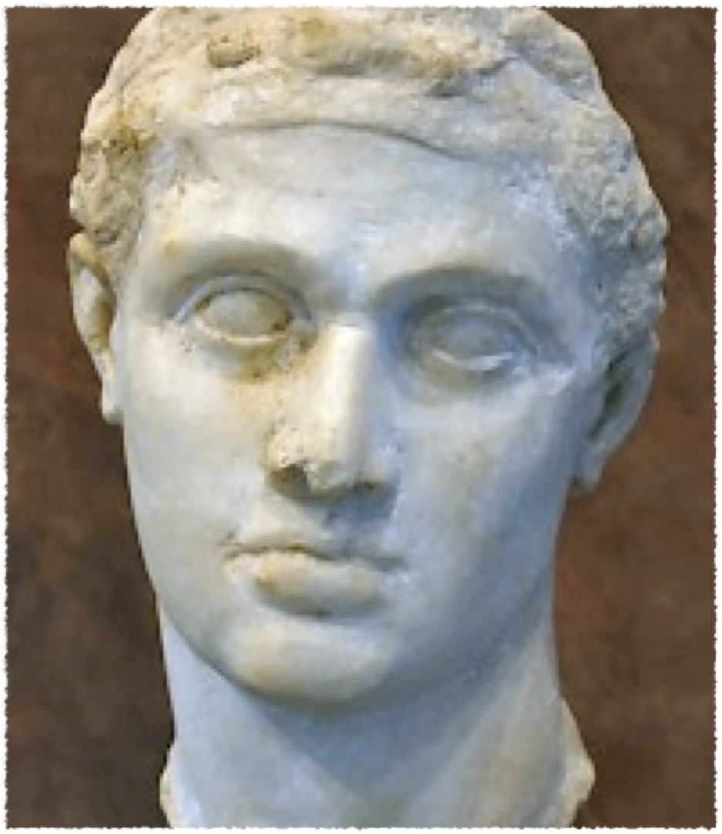
Ptolemy XIII

Slide 19
Ptolemy XIII
Ptolemy XIII Theos Philopator (The Father-loving God, born 62/61 BCE, died 47 BCE) was pharaoh of Egypt from 51 BCE until his death.
His reign began as co-ruler with his sister, the famous Cleopatra VII, following the wishes of their father, Ptolemy XII Auletes.
Ptolemy battled with Julius Caesar for control of Egypt but was defeated at the Battle of the Nile in 47 BCE.
He drowned, aged 15, while trying to escape the victorious Roman dictator.

Slide 20
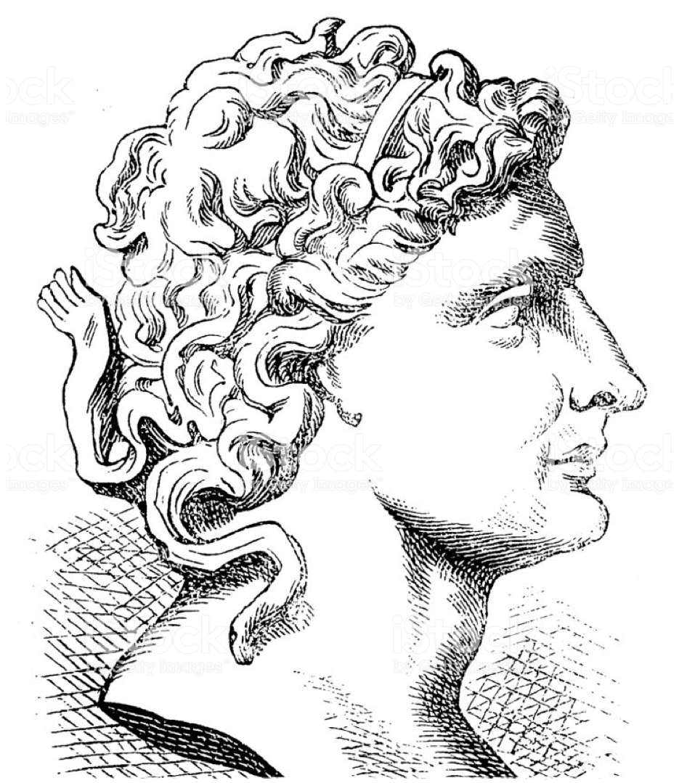
Pharnaces

Slide 21
Pharnaces
Battle of Zela 47 BC - Pharnaces II of the Kingdom of Pontus (Turkey)
Defeated by JC
Caesar travelled thorugh Asia Minor and settled the disturbances there, including those made by Pharnaces, a rebellious King.
It was after defeating Pharnaces that Caesar coined the phrase “veni, vidi, vici” which means “I came, I saw, I overcame”

Slide 22
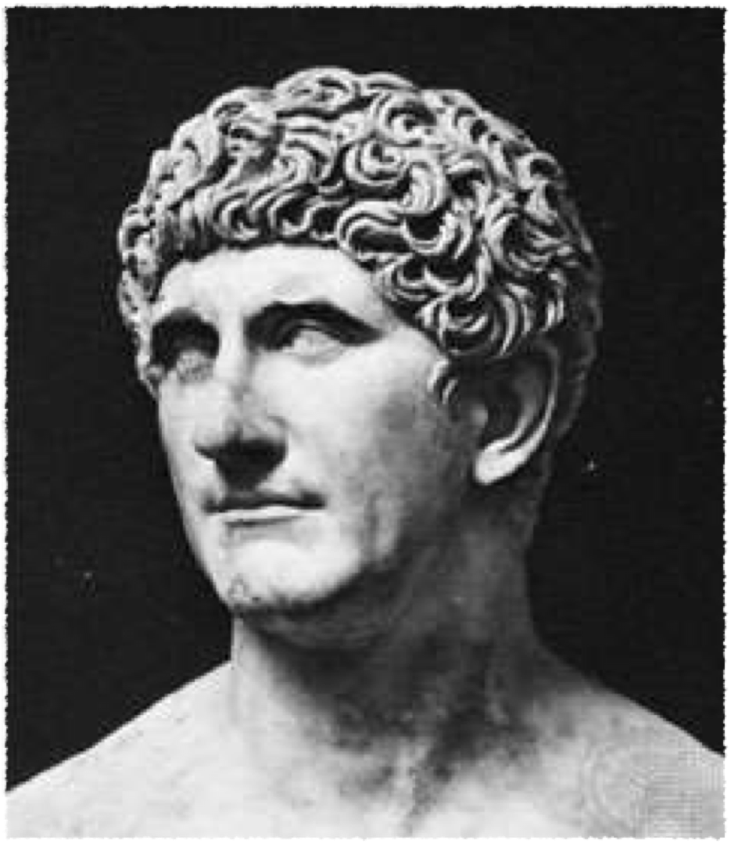
Marc Antony

Slide 23
Marc Antony
Second Triumvirate - after JC’s death
Supporter of JC and fought in Gaul
Strained for power w/Octavian - married his sister
Civil War in 31BC - Roman Senate under Octavian declared war on Cleopatra and Marc Antony as traitor
Defeated at Battle of Actium - committed suicide

Slide 24
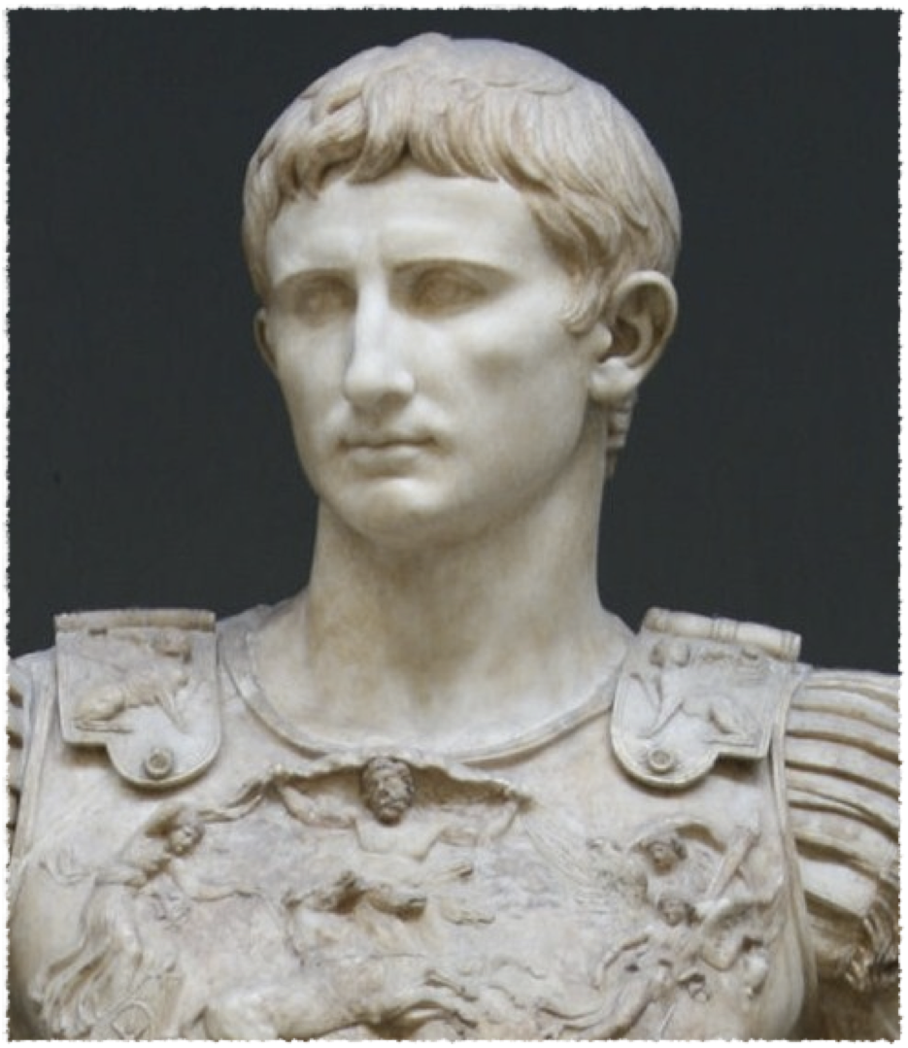
Octavian/Augustus

Slide 25
Octavian/Augustus
Second Triumvirate
First Roman Emperor
JC’s adopted son
‘The Principate’
In 32 bc Octavian, Antony’s rival for control of the Roman Empire, declared war on Cleopatra (which was really a declaration of war on Mark Antony).
Defeated at the Battle of Actium in 31 bc, Cleopatra and Antony were pursued to Egypt by Octavian. The pair committed suicide in 30 bc. This ended the Ptolemaic Dynasty; Egypt became a province of the Roman Empire.

Slide 26
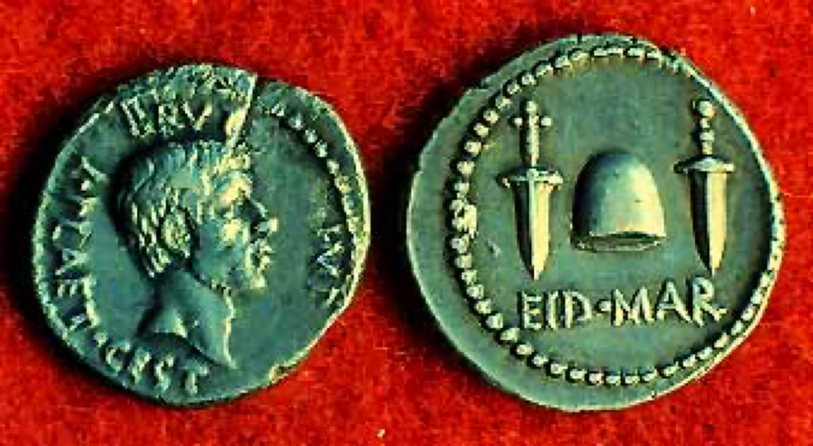
This coin, issued by Brutus, commemorates Caesar’s assassination.
Brutus had hoped he and the other conspirators would be seen as heroes liberating the Republic from a tyrant.

Slide 27
Aftermath
Caesar’s body is cremated in a massive public demonstration in the Forum. A temple is built to Divine Julius in that spot.
The conspirators are forced to flee.
Civil war again breaks out, with Caesar’s right-hand-man, Marc Antony, and his heir, Octavian, conquering the armies of Brutus, Cassius, and the Senators.

Slide 28
Lasting Impact
Caesar provided a blueprint for rising to absolute power in Rome--a blueprint both Octavian and Antony followed.
His name became one of the titles for the Roman emperors. The more modern “Czar” and “Kaiser” derive from his name too.
Caesar began the practice of granting Roman citizenship to conquered peoples. This helped to prolong the expansion and maintenance of the Roman Empire.

Slide 29
Lasting Impact
His Commentaries are one of the great pieces of Latin literature.
He inspired one of Shakespeare’s most celebrated plays.
His reform of the calendar has been changed very little over the past two millenia.
The month July is named for him.

